Slide 1
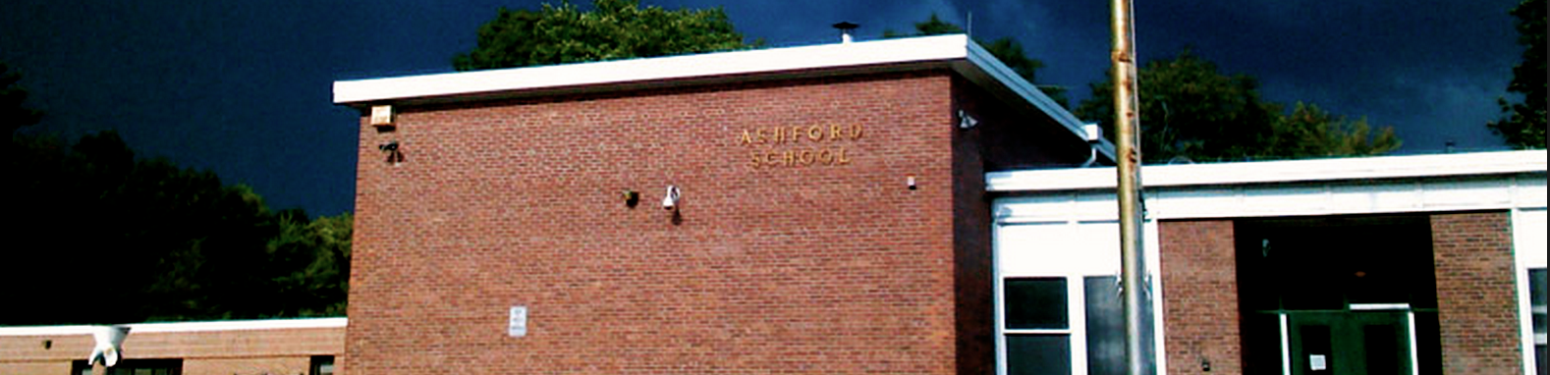
Substitute Teacher
Training and Protocols
Ashford School
440 Westford Road, Ashford, CT 06278
Click here to enter the training

Slide 2
Training Overview
Click on each individual icon below to enter the specific training sequence:
Classroom
Management and
Student Behavior
School Policies
and
Procedures

Slide 3




Overview:
Classroom Management and Student Behavior
The purpose of this training session is to provide all substitute teachers with:
Strategies for establishing and maintaining student motivation
Approaches for constructively handling student discipline issues
A step-by-step protocol for the student removal and referral process
Click to return to training overview
Click to continue

Slide 4
Get to Know the Class
Begin each day in the classroom familiarizing yourself with the information left by the classroom teacher. This will often include important information about:
Students who have specific behavior plans
Accommodations for special education students
If applicable, seating charts
Often, you can avoid many smaller behavioral issues by sticking to the routine that the students are familiar with.
Remember: You set the tone for the day. The initial impact of the substitute teacher is the key factor to a successful day in the classroom. Be self-confident, resilient, and resourceful as well as patient, honest, and enthusiastic.
Click to Continue

Slide 5
Be Sure You Understand the Lesson Plans
Read the lesson plans thoroughly. Be sure to identify any pieces of the lesson that you need to differentiate for specific students
In the case that the teacher is unable to leave lesson plans, the wall hanger containing the School Safety and Emergency Guide binder should also contain “Emergency Substitute Lesson Plans.”
Each teacher should have identified a substitute partner teacher. If you have any confusion about sub plans or have any specific questions, seek this person out before the school day begins
Follow the lesson plans as closely as possible. If a situation arises where certain tasks were not accomplished, make sure you leave a general explanation with feedback for the classroom teacher so they know where to pick up instruction upon their return
If there is an instance where there are no lesson plans and you are unable to find emergency plans, you MUST notify an administrator; additionally, document this in your substitute reflection at the end of the school day.
Click to Continue

Slide 6
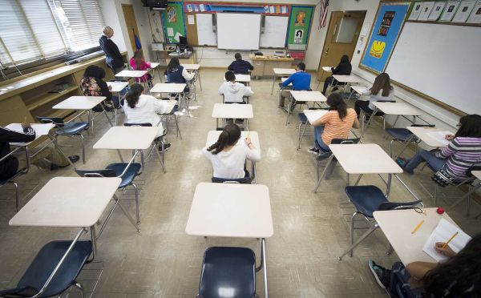

Strategies for Behavior Management
When dealing with minor behavioral infractions (inappropriate clothing, disrupting the learning of others, horse-play, throwing objects, teasing, not listening, etc.), use the following strategies to redirect the students involved:
Proximity- Often your presence when standing near a student who is off task will be enough to redirect them
Peer Role-Model- Acknowledging examples of positive behavior works well to reinforce expectations and redirect off-task behavior
Seat Change- If behavior persists, move a student’s seat to an area of the classroom where they will be less likely to distract others or to be distracted
Private Conversation- Have a private discussion with the student in the hallway, where you can address their behavior without their peers hearing the conversation
Use the Sub Partner- If a student is finding it difficult to stay on task, have them complete their work in the Sub Partners classroom
Be sure to read the sub plans carefully for specific individual behavior plans that may be in place
Click to Continue

Slide 7
Use your resources…
If there are building behavioral issues, give the office a quick phone call. If an administrator is available, they will take a walk down to the classroom to check in. Many times, this can serve to correct smaller behavioral issues.
Click to continue

Slide 8
Major Behavior Infractions
Any student who has a major behavioral infraction should immediately be sent to the main school office
However…
Please consider a student’s behavior plan, prior to making any decisions in regards to removal from the classroom.
Examples of major behavioral infractions include but are not limited to:
Verbal Threats (“I will kill you!”) For younger students (Pre-K to 2), an in-class/verbal response may be appropriate
Causing physical harm to others or to themselves - Threat to the teacher/major classroom disruption
Obscene language. For younger students (Pre-K to 2) , an in-class/verbal response may be appropriate
Breaking or damaging property - Misuse of computers (visiting inappropriate sites)
Click to continue

Slide 9
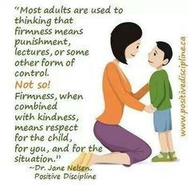
1. Speak to the student quietly, in a calm tone of voice, and in private if possible.
If a student is being sent out of the classroom, follow these simple steps:
2. Be specific about your expectations when they leave. “Please report to the main office. I will call to let them know you are on your way.”
Click to continue

Slide 10
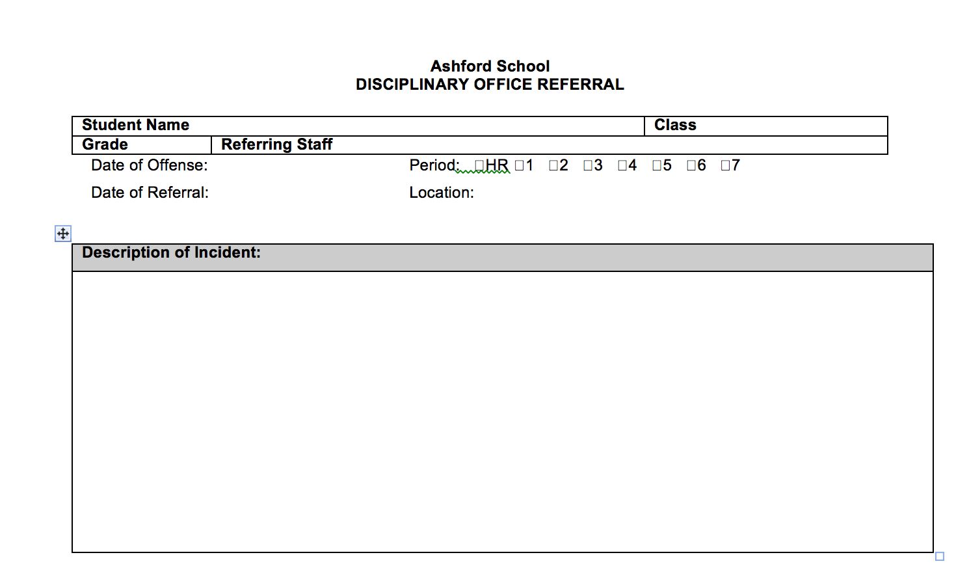
Office Referral
Procedure
_____________________
Once a student has been sent to the office for behavioral reasons, a referral is mandatory. As the person in the room during the incident, it is the responsibility of the substitute to write a referral as close to the time of the incident as possible, and no later than the end of the school day on which the incident occurs.
Steps:
As soon as a student is sent from the classroom, call the office to notify them that the student is on the way
Blank referrals can be found in the substitute plan folders in each teacher’s room
Complete the referral in its entirety and deliver it to the main office
Include a description of the incident for the classroom teacher in your end-of-day report
Click to continue

Slide 11
Remember… They are just kids…
For more information on managing student motivation and behavior, visit the following helpful site:
http://www.livesinthebalance.org/walking-tour-educators
To receive credit for completing this part of the training, please complete the “Reflection on Behavior Management Strategies” located on the school website.
Click here to visit the reflection now
Like adults, kids aren’t perfect. They make mistakes in their pursuit of learning about themselves and the world. If a student is not doing the right thing, don’t be afraid to talk to them. Showing that you genuinely care about their thoughts and opinions will go a long way with most of our students and will earn you more respect and buy-in than force or anger will.
Click here to return to Training Overview

Slide 12


Overview:
School Policies and Procedures
The purpose of this training session is to provide all substitute teachers with:
An understanding of emergency procedures at Ashford School
Direction on attendance and other procedures
Clarification of responsibilities beyond the classroom
Clear explanation of important rules and policies
Click to return to training overview
Click to continue

Slide 13
Be Prepared!
It is the responsibility of the substitute to locate the room copy of the “School Safety and Emergency Guide” binder at the beginning of any day as a substitute. There is critical information and paperwork in this binder that is necessary in the case of a fire drill or other emergency.
The substitute should also take time to study the Ashford School evacuation map, located within the “School Safety and Emergency Guide” binder to understand where you need to bring your class in the case of an evacuation or drill.
Click to Continue

Slide 14

Substitute Responsibilities During an “Evacuate School” Drill
An “Evacuate School” plan is used during a fire drill or bomb threat.
1. Remain calm and collected. Remember, your students are looking to you for guidance and protection.
2. Remove the class roster and evacuation slip from the “School Safety and Emergency Guide” binder.
3. No cell phone use allowed during an “Evacuate School” drill.
4. Escort students out to their designated fire drill area. (See school evacuation map) Count students as they leave your room. Stay as a group. No locker or bathroom visits allowed at this time.
5. Fill out your evacuation slip, complete with the names of all students present (which may include students who ARE NOT ON YOUR ROSTER) as well as the names of students who are missing.
6. Hand your evacuation slip, once completed, to the “Captain” at your designated area. This person will be holding a walkie-talkie and will be collecting slips from all groups in your designated area.
7. Maintain student silence.
8. Return to the building only when the “All Clear” signal has been given.
Click to continue

Slide 15
Substitute Responsibilities During a School Lockdown
The code for a lockdown is “AT THIS TIME IT IS NECESSARY FOR THE SCHOOL TO GO INTO A LOCKDOWN,” which will be repeated over the intercom system. During a lockdown, follow these steps:
Pull any students in the hallway that are near to your classroom into the room, then shut the door. (It should already be locked. If not, lock the door.)
Close the shades and blinds on the windows as much as possible. Close windows.
Turn off the lights and have the students sit on the floor against a wall where they are not visible from the door window, or from the exterior windows.
Ignore all fire alarms unless you physically see smoke or a fire.
Use the evacuation form to take attendance.
ONLY CALL THE OFFICE if you: have a student elsewhere (at the nurse, etc.), have a student who is not assigned to you, or have an adult in the room not assigned to your location. If your attendance is complete and normal, do not call the office.
The office will do an “all call” once the lockdown is complete.
Click to continue

Slide 16
Daily Responsibilities
1. Substitute personnel should report for their assignment to Jen Barsaleau in the Superintendent’s office no later than 8:00 AM. Half day substitutes should sign in or out, at 11:30 AM. The school day does not end until all students have left the building and are on the bus to go home.
2. At the beginning of the day (for PK- grade 4) or at the beginning of each period (grades 5-8 or specials) take attendance on the class roster. Call the office with the names of any absent students.
3. Be sure to follow all sub plans as closely as possible. Teachers spend a lot of time and effort creating lessons that minimize the impact of their absence on their students and as such it is critical that their plans are followed. If plans are confusing, seek out the substitute partner teacher for assistance or clarification.
4. Accidents, illnesses, administration of medication, or other emergencies should immediately be reported to the Principal or Assistant Principal.
5. At the end of the school day, fill out a Substitute Teacher Reflection, found on the school website and report to the Superintendent’s office to return keys and sign a payroll sheet.
Click to continue

Slide 17
Other Substitute Responsibilities
Hallway Monitoring
Cell Phone/iPad Usage
The use of cell phones is allowed in the classroom at the discretion of the teacher. Please check the lesson plans for guidance on whether or not phones are allowed in the classroom. Otherwise, cell phone use is at your discretion and based on your comfort level. Treat cell phone use as a minor discipline issue (unless the use is in direct violation of any major behavioral rules… e.g. visiting inappropriate websites, taking pictures or videos of other people, etc.) and respond accordingly.
Between class periods, please be standing in the hallway monitoring students during their passing times. Students should be walking (not running) on the right side of the hallway and maintaining a low volume. Remind students of our expectations by stating, “Please walk calmly.” “Please speak quietly, classes are in session.”
Remember: Vigilance in the hallway helps to reduce problems and injuries.
Click to continue

Slide 18
PRIVACY IS CRITICAL
Through the course of your stay in Ashford School, you will undoubtedly come across information about student needs, services, etc. You MUST treat all information as you receive about students, staff, or the school, as confidential.
Click to continue

Slide 19
Remember!
In following school policies and procedures, you are going a long way towards providing students with the consistency they need to be successful.
Familiarize yourself with evacuation routes, with your sub plans, and with the schedule for the school day. The more you prepare, the more you will meet with success as you work with our students towards their education.
Thanks for volunteering to substitute in Ashford School!
To receive credit for completing this part of the training, please complete the “Reflection on School Policies and Procedures” located on the school website.
Click here to visit the reflection now
Click to return to training overview

